Slide 1

A REAL TIME Estimation OF
TRAFFIC SPEED
Guided By – Dr. Pavan Chakraborty
Made By-
Piyush Tiwari (RIT2012003)
Angel Tiwari (RIT2012038)
Baidyanath Prasad (RIT2012010)
Anusha Chimmali (RIT2012081)
Ashish Lakra (RIT2012080)

Slide 2
Introduction
Traffic management system has been part of Intelligent Transportation System (ITS) applications that provides crucial input parameters such as lane occupation and average velocity for traffic flow prediction .
However, more information about the variation of the velocity distribution of the vehicles is also needed in order to estimate the occurrence of traffic congestion.
For analysing traffic on a road traffic network various parameters can be monitored. Such parameters include traffic flow speed profile, distance between vehicles, velocity of vehicles, vehicle classification, etc. They can be measured using various sensors like inductive loops, radars, video sensors, etc.

Slide 3
Problem Definition
Our main objective is to find the average velocity of the traffic on a particular route using image processing through Open-cv in android .This problem consists of two main modules –
1. Vehicle detection and tracking :
In order to detect the vehicle in an image frame we will have to implement the following algorithms:
a)background subtraction
- Using gaussian mixture(MOG)
b)optical flow
- Using Lucas-Kanade and tvl1.
2. Velocity Calculation:
Calculate the average through the computed distance and time from the above methods.

Slide 4
Proposed Approach
The moving object is tracked and a foreground mask of moving objects is obtained through Background Subtraction.Then the flow(displacement and time) of vehicles is obtained through Optical Flow
The calibration between pixel distance and real world distance travelled has been done to overcome perspective distortion. With this method, average velocity can be estimated independent of the position of the vehicles relative to the camera.
Capture videos
Read Image Sequence in opencv
Implement Background Subtraction
Describe best path for vehicle
Velocity Calculation through Image Processing
Implement Optical Flow

Slide 5
Assumptions-
The pixel intensities of an object do not change between consecutive frames.
Neighbouring pixels have similar motion.
Requirements-
Opencv 2.4.9,Android,Visual studio,Eclipse Juno

Slide 6
Background Subtraction
Fundamental logic for detecting moving objects from the difference between the current frame and the reference frame,called “background image” and this method is known as frame difference method

Slide 7
Simple Approach

Slide 8
Median Filter
Assuming that the background is more likely to appear in a scene,we can use the median of the previous n frames as the background model:

Slide 9
Frame Differencing

Slide 10
ALGORITHM USED :- BACKGROUND SUBTRACTER MOG
It uses a method to model each background pixel by a mixture of K Gaussian distributions (K = 3 to 5). The weights of the mixture represent the time Proportions that those colours stay in the scene. The probable background colours are the ones which stay longer and more static.

Slide 11


Optical flow
Goal : Find for each pixel a velocity vector (u , v)
• How quickly is the pixel moving across the image
• In which direction it is moving

Slide 12
Estimating Optical Flow
Assume the image intensity is constant
Time = t
Time = t+dt

Slide 13
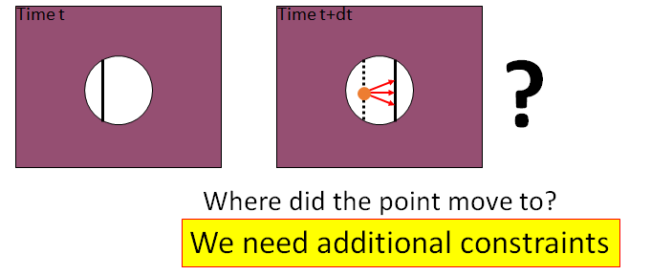
Brightness Constancy Equation
Problem I: One equation, two unknowns
Problem II: “The Aperture Problem”
For points on a line of fixed intensity we can only recover the normal flow

Slide 14
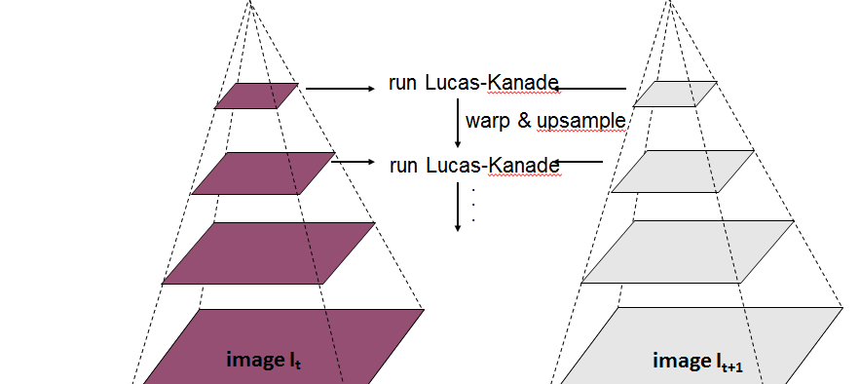
Continued..

Slide 15
Other Algos..
We Can use other method instead of optical flow for detecting the multiple moving object.
And these other may be –
1.Haar Classifier : This algorithm use contrast instead of color intensity .
2. Blob Tracking : This works on the mask, (2u*cosa+1 ) in x direction and 2u*sina+1 in y direction, these difference is in current frame and the last frame .

Slide 16
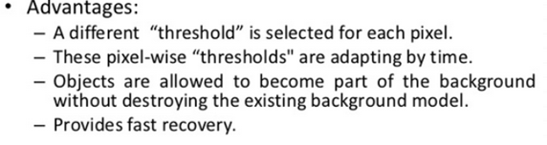
Why Optical Flow and BS Preffered??
1 . Optical Flow method can be easily used for many moving vehicles for finding their average velocity .
2. This method gives the estimated time which after taking input as a frame very effectively with maximum accuracy .

Slide 17
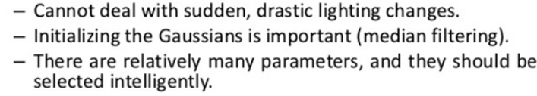
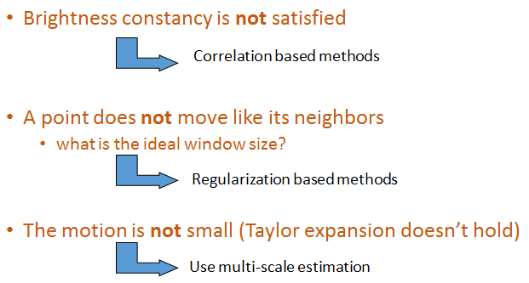
Limitations

Slide 18
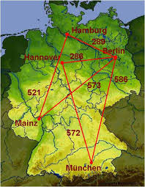
scope

Slide 19
Thank you

